Slide 1
Android Networking and Threading

Slide 2
Networking and Threading
Connecting to internet is one of the most important tasks and services for mobile devices.
Network operations can involve unpredictable delays.
To prevent this from causing a poor user experience, always perform network operations on a separate thread from the UI.

Slide 3
Networking Functions
Beginning from Android 3.0, all networking functions MUST be handled in a separated thread.
To simplify the programs, the networking examples are all implemented without multi-thread except the next one.
That means you either run those programs on Android 2.3.3 devices/emulators or change them to using Thread.

Slide 4
Threading
A Thread is a concurrent unit of execution.
Each thread has its own call stack and stores their arguments and local variables.
Each virtual machine instance has at least one main Thread running when it is started.
Then, the main Thread may create other several threads for specific purposes, such as I/O process.

Slide 5
Threading
Android modifies the user interface and handles input events from the main thread (also called UI thread).
Usually all code of an Android application runs in this thread.
If you perform a long lasting operation, e.g. loading a file or accessing data from the Internet, the user interface of your application blocks until the corresponding code has finished.

Slide 6
Threading
To provide a good user experience all potentially slow running operations in an Android application should run asynchronously, i.e. on another thread.
Android enforced that with an Application not responding (ANR) dialog if an activity does not react within 5 seconds to user input. From this dialog the user can choose to stop the application.

Slide 7
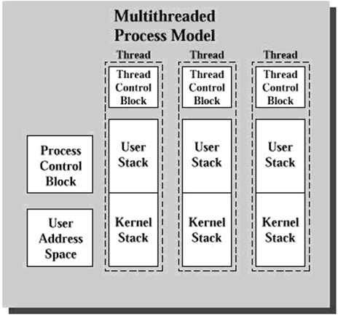
Threading
* User Address Space is the memory allocated for storing variables.

Slide 8
Threading
Advantages of Multi-Threading
Threads share the process' resources but are able to execute independently.
Applications responsibilities can be separated.
main thread runs UI, and
slow tasks are sent to background threads.
Threading provides an useful abstraction of concurrent execution.
Under multiple CPUs system, it can achieve true multi-process, thus the operations are faster.

Slide 9
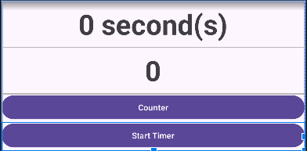
Example of Multi-Threading
The program intends to display a timer with a TextView widget showing the progress of a slow background operation (20s).
While the Timer is being started, user can also click the “Counter” button to increase the number in the TextView object by 1.

Slide 10
XML Layout of Example
<?xml version="1.0" encoding="utf-8"?>
<LinearLayout xmlns:android="http://schemas.android.com/apk/res/android"
android:id="@+id/main"
android:layout_width="match_parent"
android:layout_height="match_parent"
android:orientation="vertical"
tools:context=".MainActivity">
<TextView
android:id="@+id/tvTimer"
android:layout_width="match_parent"
…
android:text="0 second(s)" />
<TextView
android:id="@+id/tvCounter"
android:layout_width="match_parent"
…
android:text="0" />

Slide 11
XML Layout of Example
<Button
android:id="@+id/button2"
android:layout_width="match_parent"
android:layout_height="wrap_content"
android:onClick="onCount"
android:text="Counter" />
<Button
android:id="@+id/button4"
android:layout_width="match_parent"
android:layout_height="wrap_content"
android:onClick="onStartTimer"
android:text="Start Timer" />
</LinearLayout>

Slide 12
Activity Code [No Multi-Threading]
public class MainActivity extends AppCompatActivity {
TextView tvTimer;
TextView tvCounter;
int i = 0;
int timer = 0;
@Override
protected void onCreate(Bundle savedInstanceState) {
super.onCreate(savedInstanceState);
tvTimer = findViewById(R.id.tvTimer);
tvCounter = findViewById(R.id.tvCounter);
}
public void onCount(View v){
i++;
tvCounter.setText(i+"");
}

Slide 13
Activity Code [No Multi-Threading]
public void onStartTimer(View v){
try {
while (timer <= 30 ) {
sleep(1000);
timer++;
tvTimer.setText(timer+" seconds");
}
} catch (InterruptedException e) {
throw new RuntimeException(e);
}
}
}
The UI Thread cannot do anything until the loop finishes.
We must move this part of codes to another Thread!

Slide 14
Using Runnable (Thread) in a Class
Runnable is an interface defined in the java.lang package.
It serves as a functional interface for representing a task or operation that can be executed concurrently in a separate thread.
The Runnable interface provides a standard way to define and encapsulate code that can be run asynchronously.
The Runnable interface has a single method called run(), which has no arguments and doesn't return a value.

Slide 15
Using Runnable (Thread) in a Class
When a class implements the Runnable interface, it must provide an implementation for the run() method.
The code written inside the run() method represents the task or operation that will be executed when the Runnable is run in a separate thread.
To execute a Runnable in a separate thread, you typically create a new Thread instance and pass the Runnable object as a parameter to the Thread constructor.
Then, you call the start() method on the Thread instance to begin the execution of the run() method in a new thread.

Slide 16
Using Runnable (Thread) in a Class
Because we need to pass the result of a thread to the main UI thread, we need to pass the current Activity to the Thread.
And then use a Call Back method and activity.runOnUiThread() inside the run() method.
We need to use an abstract method in Java to use as a Call Back method.
As a result, we need an abstract class to contain this abstract method.

Slide 17
Abstract Class for TimerThread
public abstract class TimerThread {
Activity activity; //pass current activity
int timer = 0;
public abstract void callResult(int timer); //call back method
public TimerThread(Activity activity){
this.activity = activity; //pass current activity
}

Slide 18
Abstract Class for TimerThread
public void runTimer(){ //call Thread
Thread thread = new Thread(new Runnable(){
@Override
public void run() {
try {
while (running) {
sleep(1000);
timer++;
activity.runOnUiThread(new Runnable() {
public void run() {
callResult(timer); //pass timer to UI Thread
}
}); }
} catch (Exception e) {
throw new RuntimeException(e);
}
}
});
thread.start();
}
}

Slide 19
Activity Code use Async Thread
public class MainActivity extends AppCompatActivity {
TextView tvTimer;
TextView tvCounter;
int i = 0;
MyThread myThread;
@Override
protected void onCreate(Bundle savedInstanceState) {
super.onCreate(savedInstanceState);
setContentView(R.layout.activity_main);
tvTimer = findViewById(R.id.tvTimer);
tvCounter = findViewById(R.id.textView2);
myThread = new MyThread(this);
}
private class MyThread extends TimerThread {
@Override
//Call Back
public void callResult(int timer) { //pass timer from TimerThread to UI Thread
tvTimer.setText(timer+" second(s)");
}
}

Slide 20
Activity Code use Async Thread
public void onCount(View v){
i++;
tvCounter.setText(i+"");
}
public void onStartTimer(View v){
myThread.runTimer();
}
}

Slide 21
HTTP
HTTP stands for hyper text transport protocol.
HTTP is the standard transport protocol for web browser <----> web server communication.
One of the key features of HTTP is that communication is stateless between requests.
Android contains the Apache HttpURLConnection library for performing network operations in Android.
Obtain a new HttpURLConnection by calling URL.openConnection() and casting the result to HttpURLConnection.
The url address should be typed correctly and the protocol (i.e. https://) MUST be included!

Slide 22
Codes for HTTPConnection
Those codes below must be executed inside a Thread!
URL url = new URL("https://www.vtc.edu.hk");
HttpURLConnection conn =
(HttpURLConnection) url.openConnection();
conn.setRequestMethod("GET");
// Starts the query
conn.connect();
InputStream inputStream = conn.getInputStream();
BufferedReader bufferedReader =
new BufferedReader(new InputStreamReader(inputStream));
String line = "";
while((line = bufferedReader.readLine()) != null)
data += line;
//contents of url will be stored into the variable data
inputStream.close();
Log.d("Background =>", " " + data);
inputStream.close();

Slide 23
Internet Permission
To access the internet your application requires the "android.permission.INTERNET" permission in the file AndroidManifests.xml.
<?xml version="1.0" encoding="utf-8"?>
<manifest xmlns:android="http://schemas.android.com/apk/res/android"
android:versionCode="1"
android:versionName="1.0">
<uses-permission android:name="android.permission.INTERNET" />
<application android:icon="@drawable/icon" android:label="@string/app_name">
<activity android:name=".JSONExample"
android:label="@string/app_name">
<intent-filter>
<action android:name="android.intent.action.MAIN" />
<category android:name="android.intent.category.LAUNCHER" />
</intent-filter>
</activity>
</application>
</manifest>

Slide 24
Abstract Class for HttpThread
public abstract class HttpThread {
Activity activity;
private String urlString ;
String data = "";
public HttpThread(String url, Activity activity){
this.activity = activity;
this.urlString = url;
}
public abstract void callResult(String data); //Call Back method, pass url contents to UI Thread
public void fetchPage(){
Thread thread = new Thread(new Runnable(){
@Override
public void run() {
try {
URL url = new URL(urlString);
HttpURLConnection conn = (HttpURLConnection) url.openConnection();
conn.setRequestMethod("GET");
// Starts the query
conn.connect();

Slide 25
Abstract Class for HttpThread
InputStream inputStream = conn.getInputStream();
BufferedReader bufferedReader =
new BufferedReader(new InputStreamReader(inputStream));
String line = "";
while((line = bufferedReader.readLine()) != null)
data += line;
inputStream.close();
activity.runOnUiThread(new Runnable() {
public void run() {
callResult(data); //Call Back
}
});
Log.d("Background =>", " " + data);
} catch (Exception e) {
e.printStackTrace();
Log.d("Thread Error", e.getMessage());
}
}
});
thread.start();
}
}

Slide 26
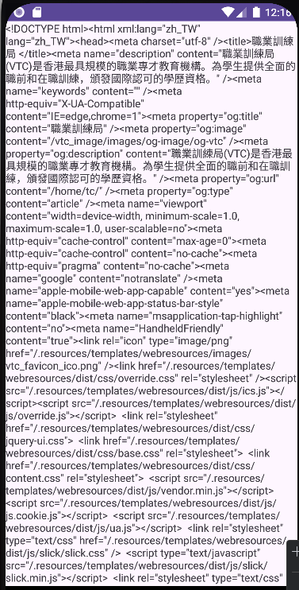
Example - FetchAPageSource
This example demonstrates how to fetch a web page and display the content in using a TextView.

Slide 27
Activity codes to load www.vtc.edu.hk
public class MainActivity extends AppCompatActivity {
TextView tvResult;
MyThread myThread;
public static final String MYURL = "https://www.vtc.edu.hk";
@Override
protected void onCreate(Bundle savedInstanceState) {
super.onCreate(savedInstanceState);
setContentView(R.layout.activity_main);
tvResult = findViewById(R.id.tvResult);
myThread = new MyThread(MYURL);
myThread.fetchPage();
}

Slide 28
Activity codes to load www.vtc.edu.hk
private class MyThread extends HttpThread {
public MyThread(String url) {
super(url);
}
@Override
//Call Back to UI Thread
public void callResult(String data) {
Log.d("Result", data);
tvResult.setText(data);
}
}
}

Slide 29
Embedded Browser (WebView)
There are several reasons why an application may want to have access to a web browser.
Example: display HTML fragments, access external services, open Google search etc.
Additionally, accessing HTTP resources without a web browser abstraction layer is tedious and unnecessary.
Android provides two solutions to this issue:
Use an Intent to cause Android to launch its own system browser (discussed in another chapter).
Embed a WebView controller inside an Activity
Both of these approaches have their own unique advantages and disadvantages.

Slide 30
Using WebView
The WebView controller allows for HTML fragments and web pages to be displayed in an activity.
WebView interacts with an Android activity like any other widget.
As such, an activity can capture events and as well as interact with the DOM on the page.
Unfortunately, the WebView implementation does not support AJAX out of the box.

Slide 31
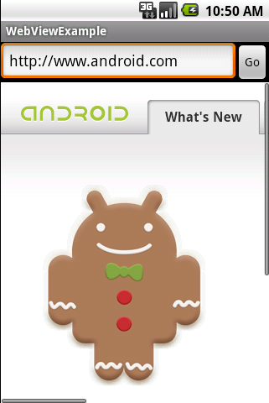
WebViewExample
Three widgets:
EditText contains the URL to load.
A Go button to start page loading.
A WebView to display the page
Note:
The protocol (e.g. http://) is required.
If the URL (e.g. https://www.vtc.edu.hk) has a redirect, the default behavior for Android is to launch a browser to handle it.
You may use WebViewClient and shouldOverrideUrlLoading() to catch the redirect and re-route them back to the WebView.

Slide 32
WebViewExample – main.xml
<?xml version="1.0" encoding="utf-8"?>
<LinearLayout
xmlns:android="http://schemas.android.com/apk/res/android"
android:orientation="vertical"
android:layout_width="match_parent"
android:layout_height="match_parent">
<LinearLayout android:orientation="horizontal"
android:layout_width="match_parent"
android:layout_height="wrap_content">
<EditText
android:id="@+id/url_field"
android:layout_width="wrap_content"
android:layout_height="wrap_content"
android:layout_weight="1.0"
android:lines="1"
android:inputType="textUri"
android:imeOptions="actionGo" />
<Button
android:id="@+id/go_button"
android:layout_width="wrap_content"
android:layout_height="wrap_content"
android:text="Go" />
</LinearLayout>
<WebView
android:id="@+id/web_view"
android:layout_width="match_parent"
android:layout_height="wrap_content"
android:layout_weight="1.0" />
</LinearLayout>

Slide 33
WebViewExample.java
import android.webkit.WebView;
public class WebViewExample extends AppCompatActivity {
private EditText urlText;
private Button goButton;
private WebView webView;
@Override
public void onCreate(Bundle savedInstanceState) {
super.onCreate(savedInstanceState);
setContentView(R.layout.main);
// Get a handle to all user interface elements
urlText = findViewById(R.id.url_field);
goButton = findViewById(R.id.go_button);
webView = findViewById(R.id.web_view);
// The following code is to force WebView to load links
webView.setWebViewClient(new WebViewClient(){
@Override
public boolean shouldOverrideUrlLoading(WebView view,
WebResourceRequest request) {
return false;
}});

Slide 34
WebViewExample.java
// Setup event handlers
goButton.setOnClickListener(new OnClickListener() {
public void onClick(View view) {
openBrowser();
}
});
urlText.setOnKeyListener(new OnKeyListener() {
public boolean onKey(View view, int keyCode,
KeyEvent event) {
if (keyCode == KeyEvent.KEYCODE_ENTER) {
openBrowser();
return true;
}
return false;
}
});
}
/** Open a browser on the URL specified in the text box */
private void openBrowser() {
webView.getSettings().setJavaScriptEnabled(true);
webView.loadUrl(urlText.getText().toString());
}
}

Slide 35
REST Web Services
REST stands for Representational State Transfer.
REST is a style of software architecture for distributed hypermedia systems such as the World Wide Web.
A RESTful web service (also called a RESTful web API) is a simple web service implemented using HTTP and the principles of REST.

Slide 36
JSON
JavaScript Object Notation (JSON) is a lightweight text-based open standard designed for human-readable data interchange.
It is derived from the JavaScript programming language and is language-independent, with parsers available for most programming languages.
Similar to XML and has quickly become one of the most popular formats for data exchange on the internet.

Slide 37
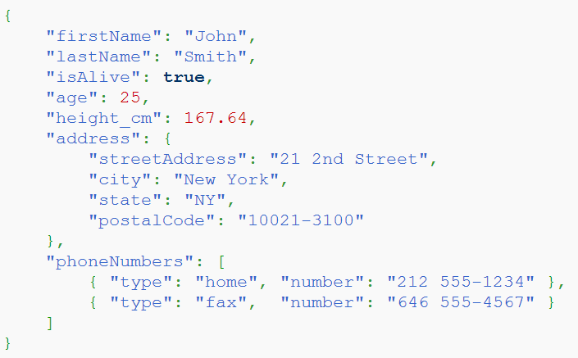
JSON
Example A JSON personal record
Why JSON?
JSON is faster and easier than XML.

Slide 38
JSON
JSON Syntax Rules
Data is in name/value pairs
Data is separated by commas
Curly braces hold objects
Square brackets hold arrays
JSON Name/Value Pairs
JSON data is written as name/value pairs:
"firstName" : "John"
JSON value can be: a number, a string, a Boolean, an array, an object or null
Can you give an example for each of the JSON value type from the above JSON personal record?

Slide 39
JSON
JSON Objects
JSON objects are written inside curly brackets,
Objects can contain multiple name/values pairs:
{ "firstName":"John" , "lastName":"Doe" }
JSON Arrays
JSON arrays are written inside square brackets.
An array can contain multiple objects:
{ "employees": [ { "firstName":"John" , "lastName":"Doe" }, { "firstName":"Anna" , "lastName":"Smith" }, { "firstName":"Peter" , "lastName":"Jones" } ] }

Slide 40
Parsing JSON Data
A typical Android network application is to retrieve a JSON data from internet.
Your task is to parse it and obtain the values it stores.
Android provides a set of API to parse a JSON data.
Your very first step is to create a JSON object for the data received:
JSONObject jObj = new JSONObject(data);
Then you can use this object with the getXXX methods to extract the values from the JSON data.

Slide 41
JSONObject get Methods
Object | get(String name) Returns the value mapped by name.
boolean | getBoolean(String name) Returns the value mapped by name if it exists and is a boolean or can be coerced to a boolean.
double | getDouble(String name) Returns the value mapped by name if it exists and is a double or can be coerced to a double.
int | getInt(String name) Returns the value mapped by name if it exists and is an int or can be coerced to an int.
JSONArray | getJSONArray(String name) Returns the value mapped by name if it exists and is a JSONArray.
JSONObject | getJSONObject(String name) Returns the value mapped by name if it exists and is a JSONObject.
long | getLong(String name) Returns the value mapped by name if it exists and is a long or can be coerced to a long.
String | getString(String name) Returns the value mapped by name if it exists, coercing it if necessary.

Slide 42
Parsing JSONObject
Suppose data stores the string shown and a JSONObject is created
JSONObject jObj = new JSONObject(data);
To get the first name you use
String fName = jObj.getString("firstName");
To get the age you use
int age = jObj.getInt("age");
A slightly more complicated example: to get the city you need two steps:
JSONObject addrObj = jObj.getJSONObject("address");
String city = addrObj.getString("city");

Slide 43
Parsing JSONArray
JSONArray provides similar getXXX methods as JSONObject with index, instead of name, as the parameter. Also it provides the method length() which returns the numbers of element it holds.
The index begins from 0.
For example, to get the fax number (index 1) you need three steps:
JSONArray phoneArray = jObj.getJSONArray("phoneNumbers");
JSONObject faxObj = phoneArray.getJSONObject(1);
String fax = faxObj.getString("number");
The above lines can be combined into one statement:
String fax = jObj.getJSONArray("phoneNumbers"). getJSONObject(1).getString("number");

Slide 44
API JSON Example
There are many public API provides a RESTful web service for HTTP clients. We are going to write an application that can provide Hong Kong weather information.
Usually we need to apply a API Key before to apply the API in your app.
Please go to https://openweathermap.org to apply your own API key.
You can directly use an URL in a browser to test your API and get the corresponding JSON.
Following URL can get the current Hong Kong weather:
http://api.openweathermap.org/data/2.5/weather?q=Hong%20kong,hk&units=metric&appid=yourapikey

Slide 45
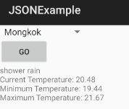
API JSON Example
Widgets:
One Spinner object (Cities List).
One Button to get the JSON.
One TextView to hold the result.

Slide 46
API JSON Example
The following table lists the required URL arguments.
Argument | Example | Description
q | q=Hong%20Kong,hk | city and country.
units | units=metric | use Celsius.
appid | appid=yourapikey | key to use this api, you must sign up at openweathermap.org and then get the key.

Slide 47
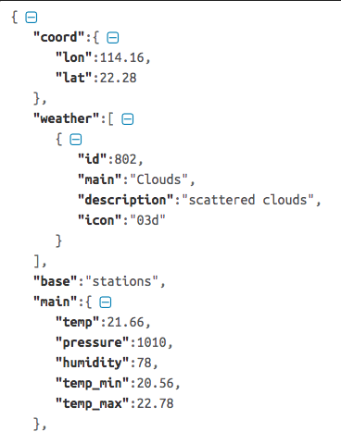
API JSON Example
API documents for current weather
https://openweathermap.org/current
JSON sample:

Slide 48
API JSON Example
public class JSONExample extends AppCompatActivity {
private Spinner spinnerCity;
private TextView textDescription;
FetchPageTask task = null;
@Override
public void onCreate(Bundle savedInstanceState) {
super.onCreate(savedInstanceState);
setContentView(R.layout.main);
spinnerCity = findViewById(R.id.city);
textDescription = findViewById(R.id.description);
// Spinner user interface uses standard layouts
String cities[] = { "Hong Kong", "Kowloon", "Central", "Mongkok",
"Kowloon City", "Sheung Wan", "Tsuen Wan", "Tsim Sha Tsui"};
ArrayAdapter<String> adapter = new ArrayAdapter<String>(this,
android.R.layout.simple_spinner_item, cities);
adapter.setDropDownViewResource(
android.R.layout.simple_spinner_dropdown_item);
spinnerCity.setAdapter(adapter);
// Automatically select first spinner items
spinnerCity.setSelection(0); // English (en)
}

Slide 49
API JSON Example
public void onClick(View view) {
if (task == null || task.getStatus().equals(AsyncTask.Status.FINISHED)) {
task = new FetchPageTask();
task.execute(spinnerCity.getSelectedItem().toString());
}
}
private class FetchPageTask extends AsyncTask<String, Integer, String> {
@Override
protected String doInBackground(String... values) { // parameters not
String result="";
URL url = null;
InputStream inputStream = null;
try {
url = new URL("https://api.openweathermap.org/data/2.5/weather?
units=metric&appid=yourapikey
&q="+values[0]+",hk");
//use codes in slide 35
...
}

Slide 50
API JSON Example
@Override
protected void onPostExecute(String result) {
// Parse to get weather information in String result
try {
JSONObject jObj = new JSONObject(result);
JSONArray weather = jObj.getJSONArray("weather");
String description = weather.getJSONObject(0)
.getString("description");
String temp = jObj.getJSONObject("main")
.getString("temp");
String temp_min = jObj.getJSONObject("main")
.getString("temp_min");
String temp_max = jObj.getJSONObject("main")
.getString("temp_max");
textDescription.setText(description+"\n"+
"Current Temperature: "+temp+"\n"+
"Minimum Temperature: "+temp_min+"\n"+
"Maximum Temperature: "+temp_max);
} catch (Exception e) {
String error = e.getMessage();
textDescription.setText(error);
}
}

